Slide 1
Footprinting Contd.

Slide 2
Steps
DNS footprinting
Whois footprinting
NS Lookup
MX Lookup
Footprinting through Discovery

Slide 3
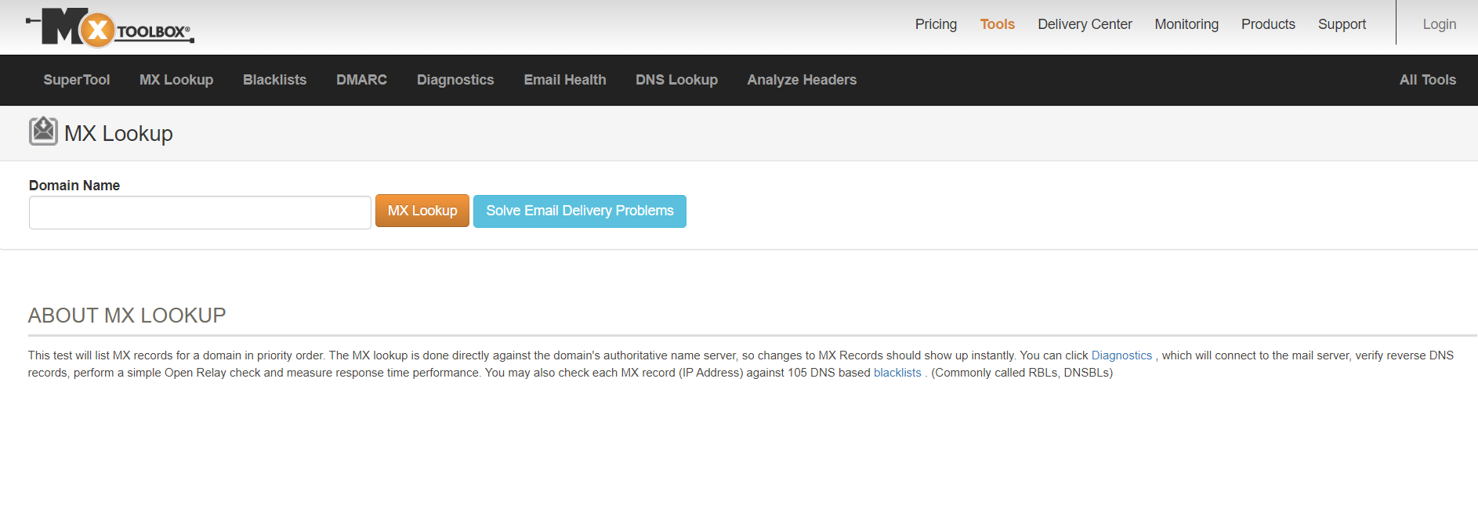
DNS footprinting
Open Mxtoolbox.com in browser
Click all tools

Slide 4
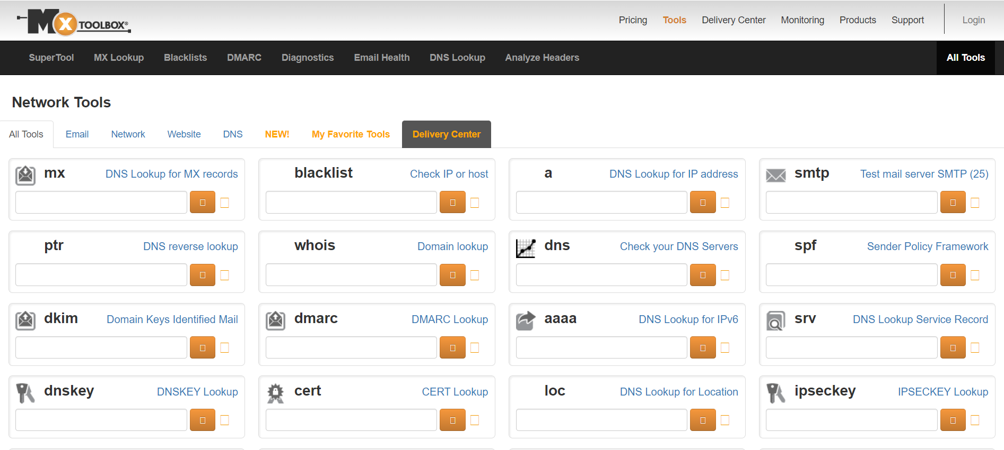
Type domain name

Slide 5
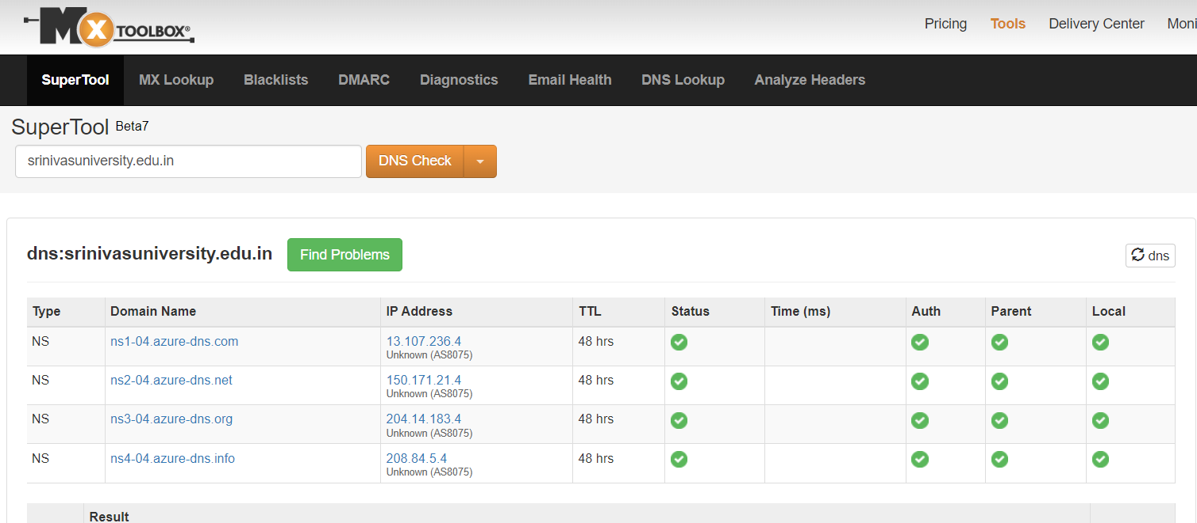

Slide 6

Scroll Down and Click

Slide 7
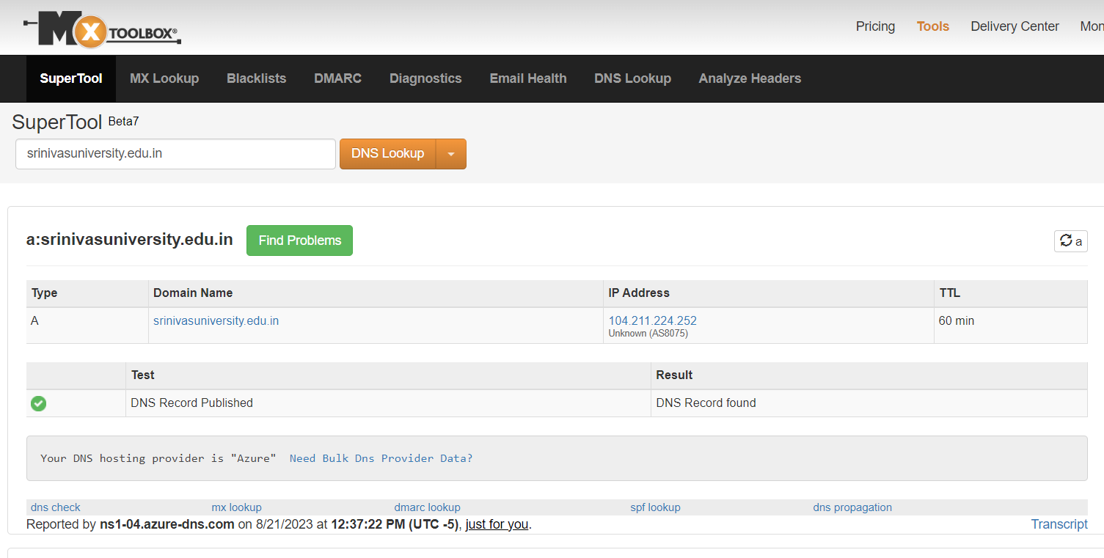

Slide 8
2. Whois footprinting
Type Url

Slide 9
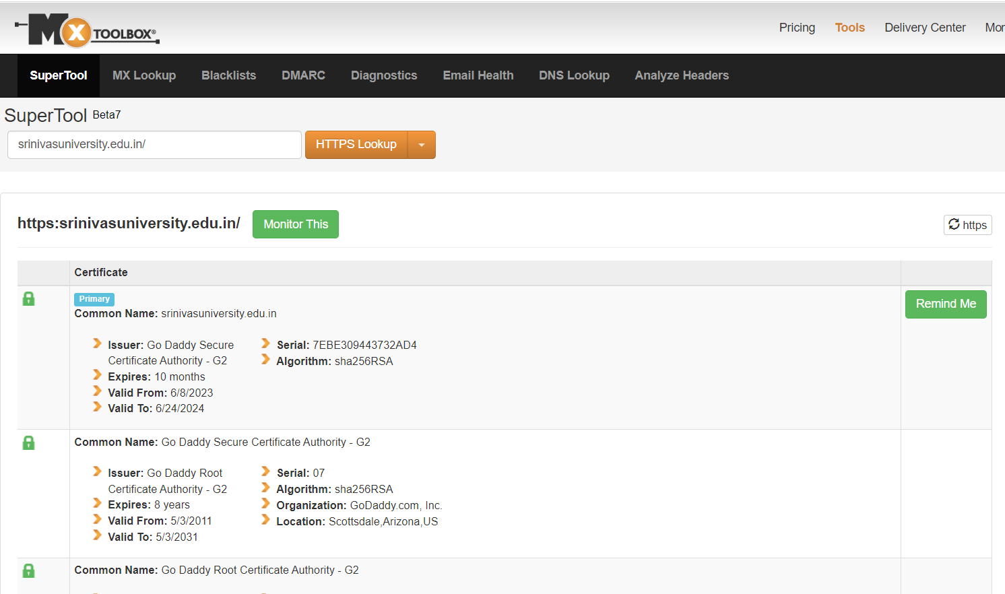

Slide 10
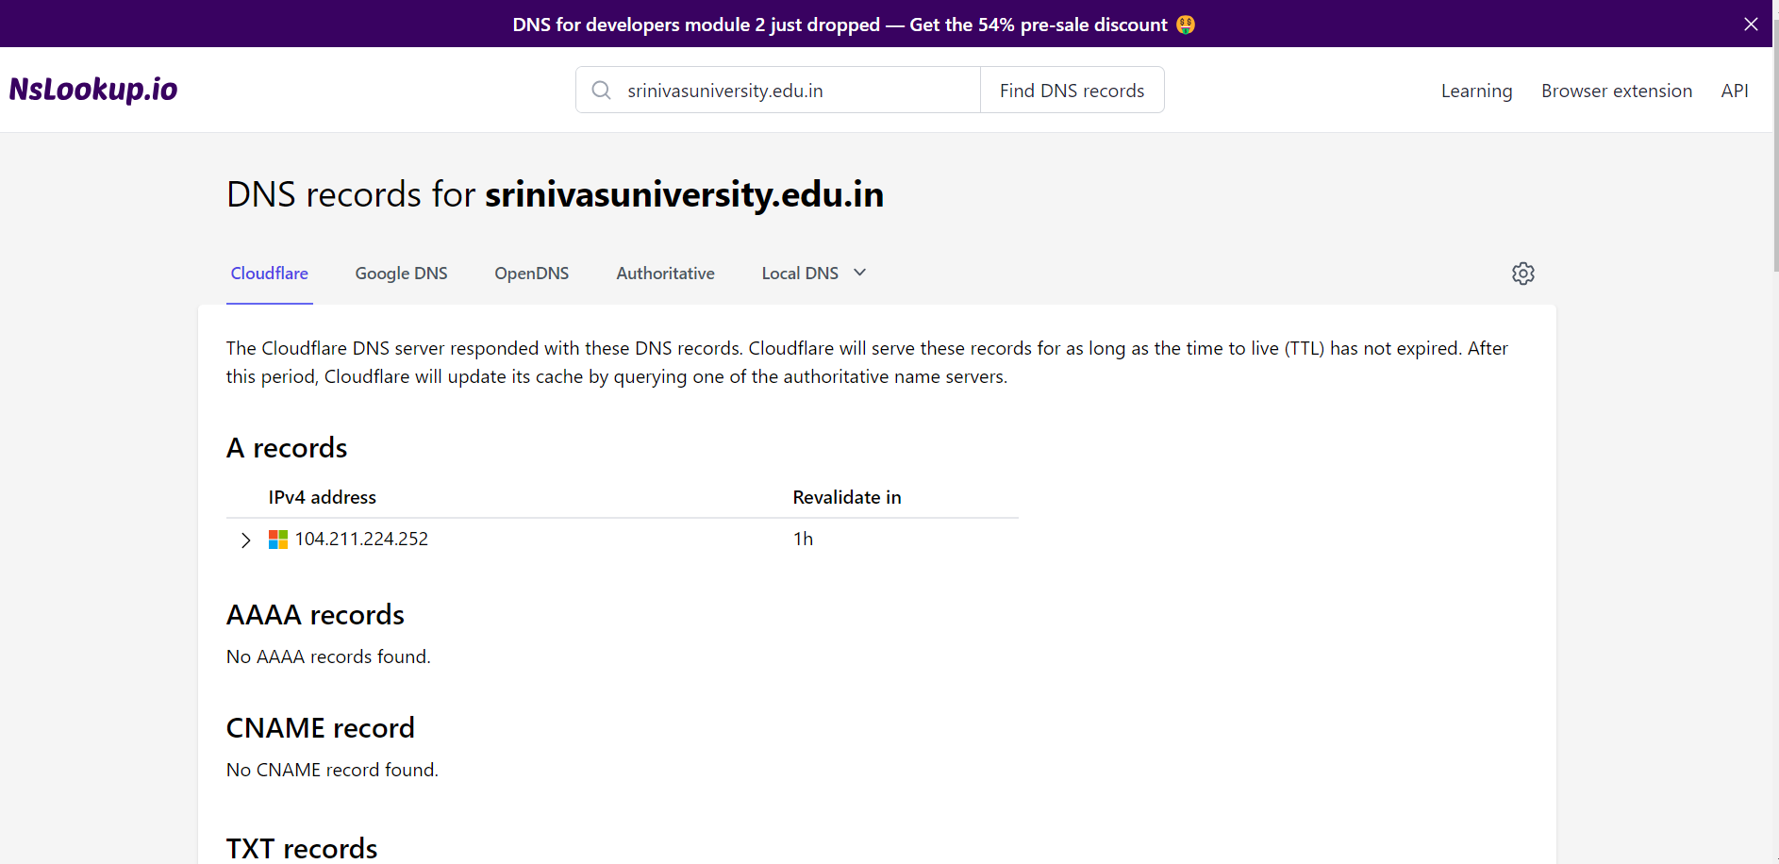
Ns Look Up

Slide 11
4. MX Lookup
TypeURL

Slide 12

5. Footprinting through Discovery

Slide 13


Slide 14
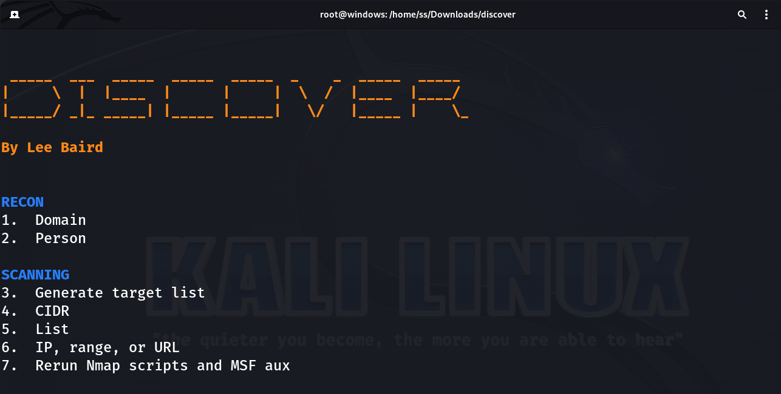

Slide 15
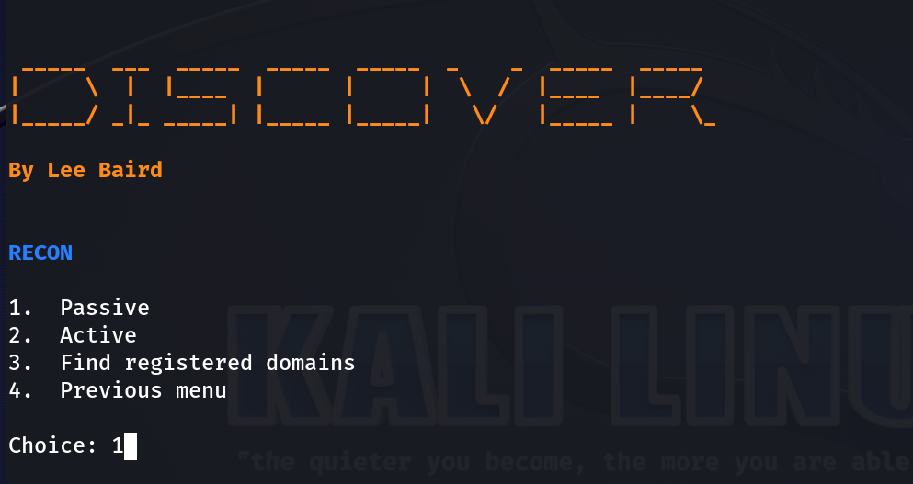
Select choice 1 Passive domain

Slide 17
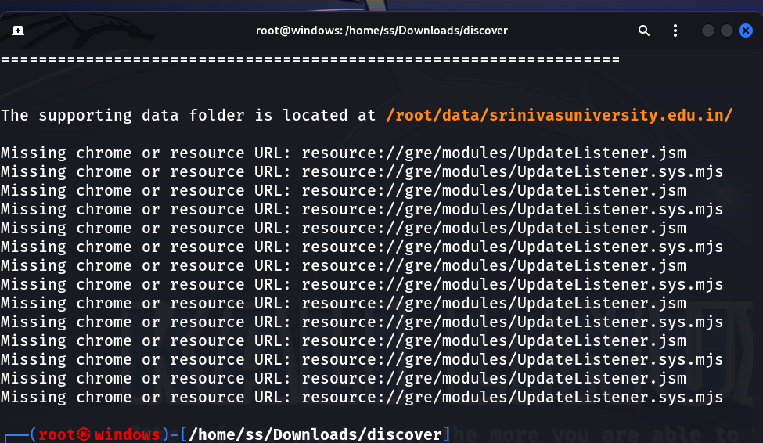

Slide 18
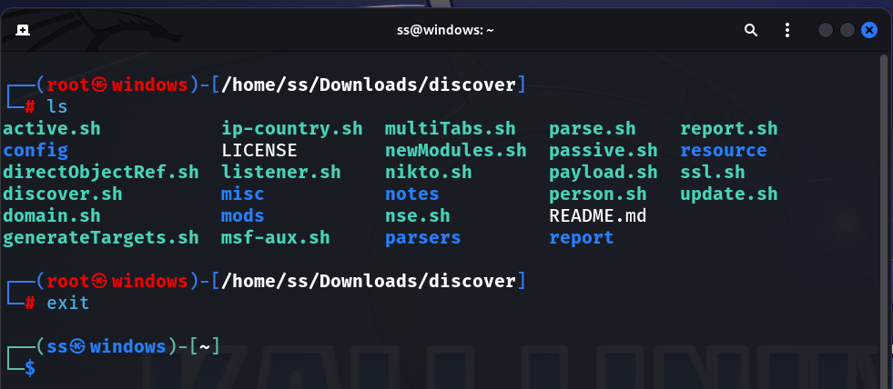

Slide 19


Slide 20
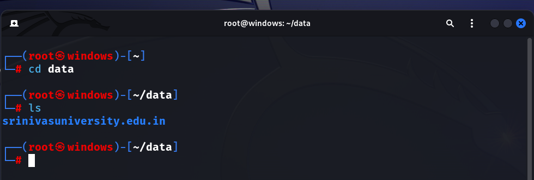


Slide 22
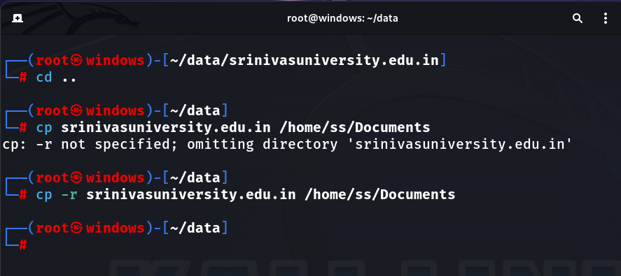

Slide 23
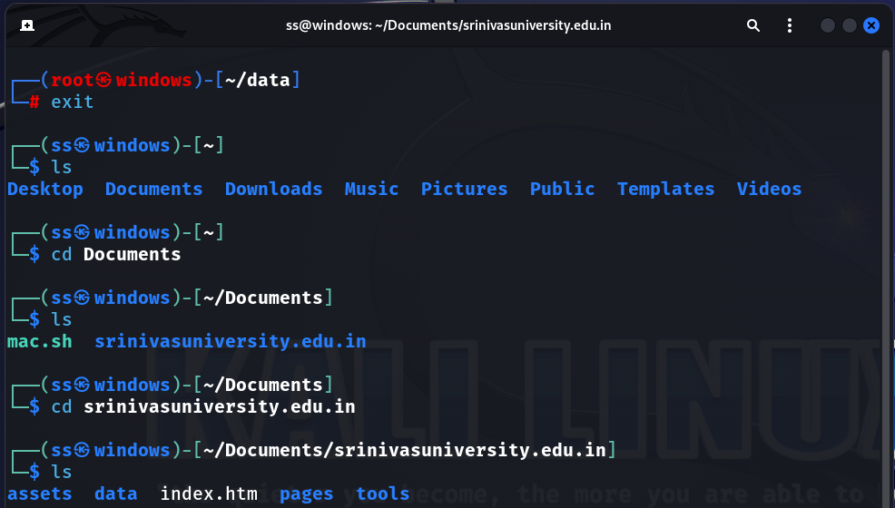

Slide 24
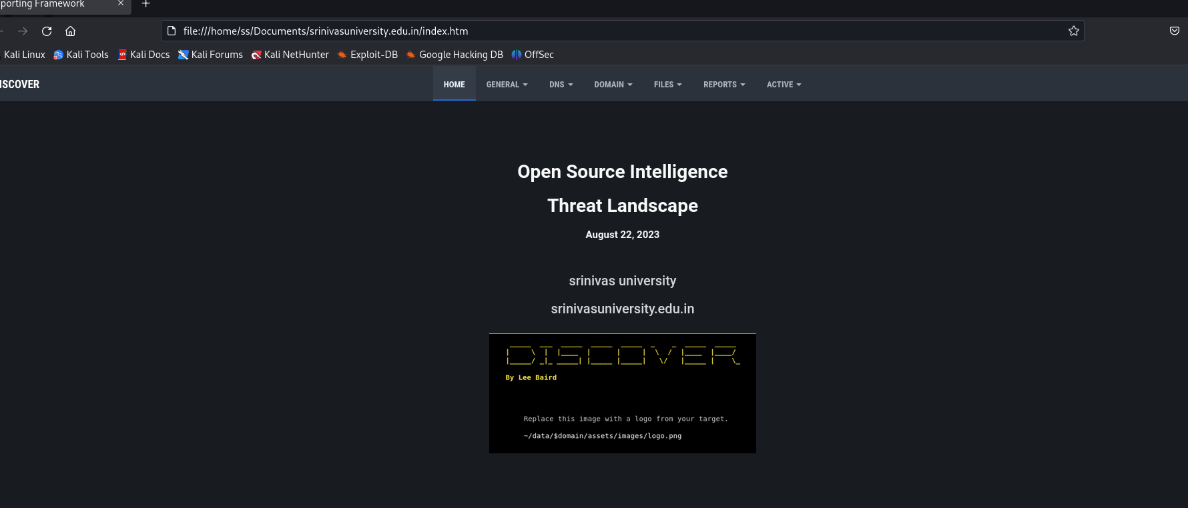

Slide 25
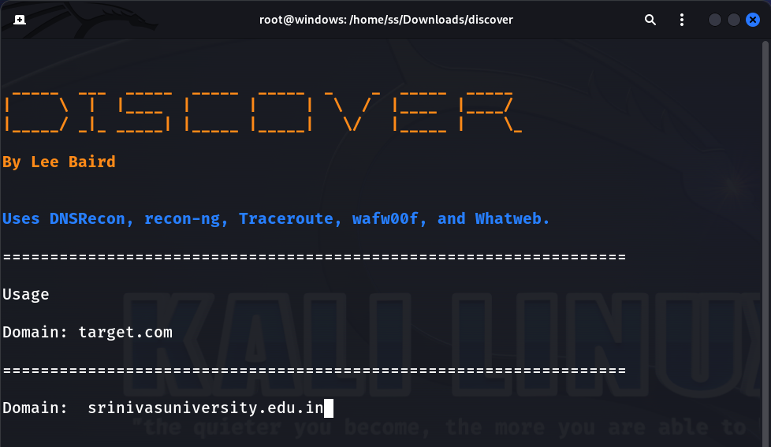
Select choice 2 Active domain

Slide 26
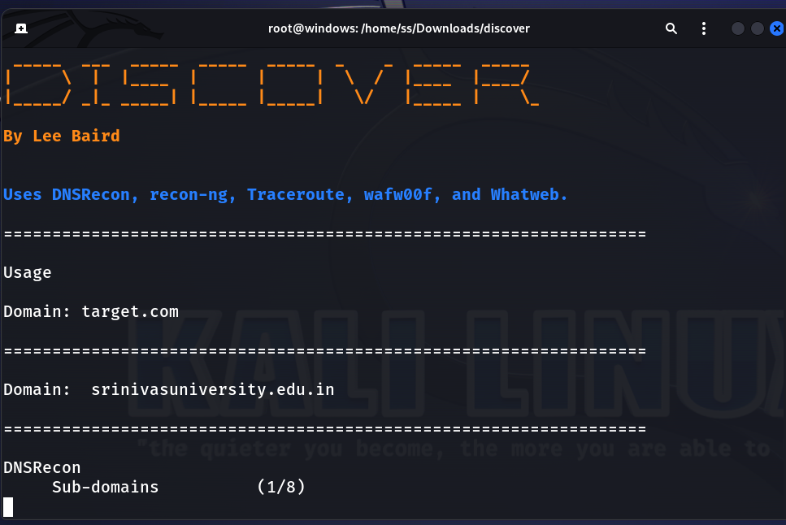

Slide 27
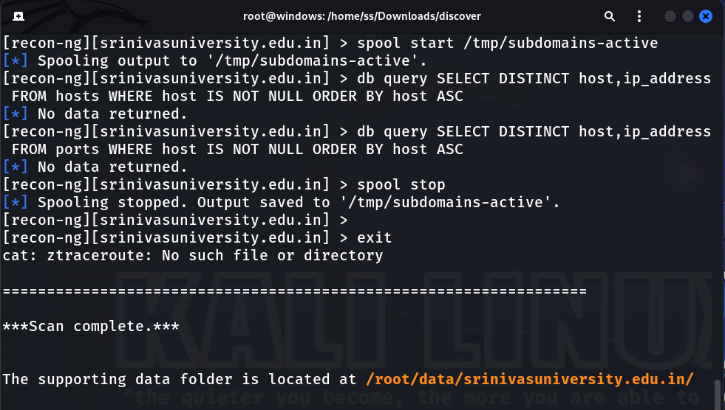

Slide 28
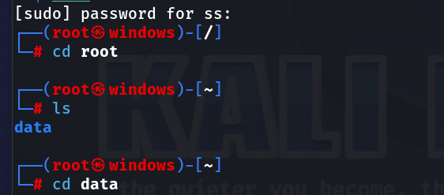

Slide 29
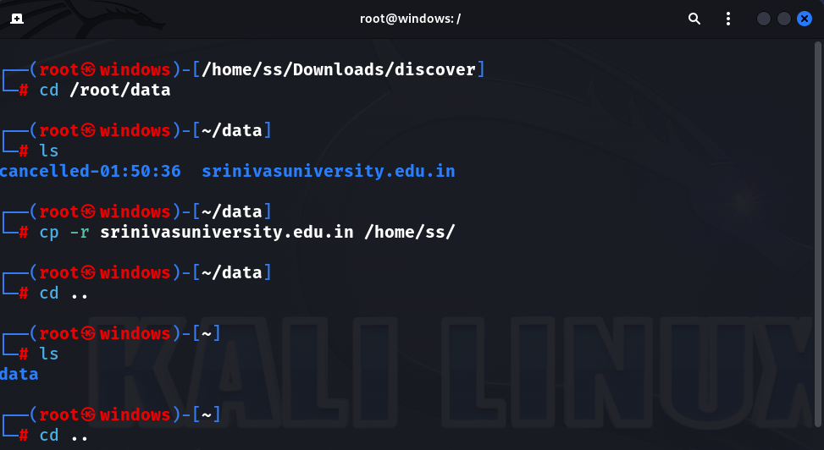

Slide 30


Slide 31
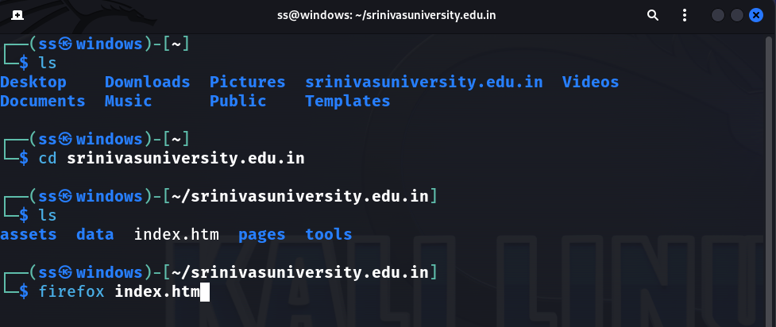
Open new terminal

Slide 32
